Slide 1
DEMOGRAPHIC AND ECONOMIC INSIGHTS
OF INCOME, OCCUPATION, AND PURCHASING BEHAVIOR

Slide 2
ADDED CELLS TO THE DATA
SIMPLIFIED INCOME This data helps explain income by grouping it into categories. The grouping was achieved using an IF statement to classify the income into the following categories:
LOW INCOME
MEDIUM INCOME
HIGH INCOME
HIGHEST INCOME
Formula- =IF(D2<=40000,"LOW INCOME",IF(D2<=80000,"MEDIUM INCOME",IF(D2<=100000,"HIGH INCOME","HIGHEST INCOME")))

Slide 3
ADDED CELLS TO THE DATA
SIMPLIFIED COMMUTE DISTANCE The commute distance in miles was analyzed, and its average was calculated. To make the explanation simpler, the data was grouped into categories based on the average commute distance. The categories created are:
CLOSEST
FAR
FURTHEST
Formula- =IF(L2<=4.5,"CLOSEST",IF(L2<=7.5,"FAR","FURTHEST"))

Slide 4
ADDED CELLS TO THE DATA
HELPER 1
To perform a VLOOKUP, I created a new helper column called Helper 1, which combines the Simplified Income, Education, and Occupation values. The formula I used for concatenation is as follows:
Formula-=E2&"-"&G2&"-"&H2
The VLOOKUP function is then used to check the combination of the Simplified Income, Education, and Occupation by using the person’s ID. The formula used is:
Formula-= =VLOOKUP($Q$12,$A2:$P$1001,16,FALSE)

Slide 5
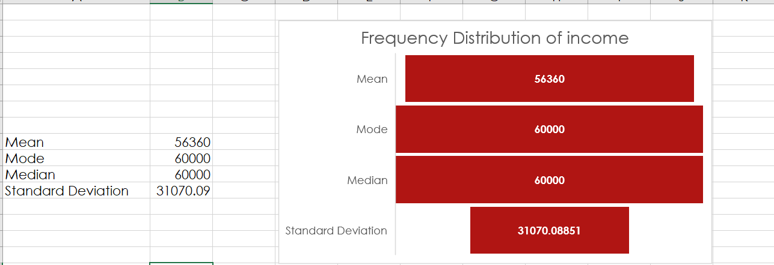
FREQUENCY DISTRIBUTION OF INCOME CHART

Slide 6
FREQUENCY DISTRIBUTION OF INCOME EXPLANATION
The average income is around $56,000, with the most common income being $60,000. Half the incomes are above $60,000 and half are below.
However since the standard deviation of $31,070.09 is more than half of $56,360, the spread is considered moderate to high.
In practical terms, it might mean that income inequality exists within this dataset, with some individuals earning much less or much more than the typical income.

Slide 7
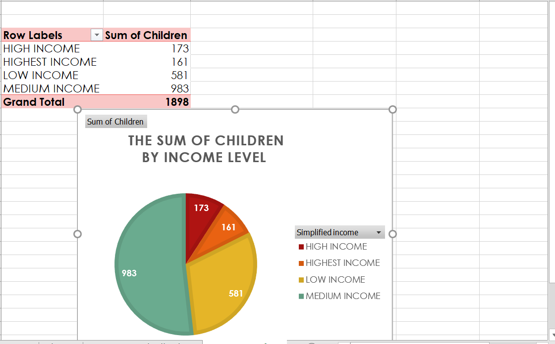
KPI 1-- INCOME VS. THE SUM OF CHILDREN CHART

Slide 8
KPI 1-- INCOME VS. THE SUM OF CHILDREN EXPLANATION
Purpose: Examines the relationship between household income levels and the number of children.
Key Insights:
Identifies whether higher-income households tend to have more or fewer children.
Explores potential financial burdens or lifestyle choices linked to family size.
Applications: Insights could inform policies or products targeted at families in specific income brackets.

Slide 9
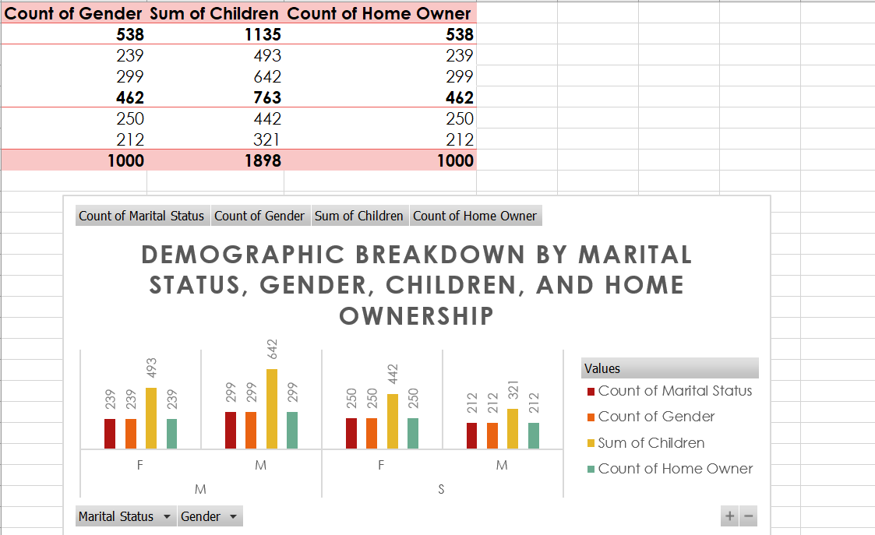
KPI 2-- DEMOGRAPHIC BREAKDOWN CHART

Slide 10
KPI 2-- DEMOGRAPHIC BREAKDOWN EXPLANATION
Purpose: Provides a snapshot of population characteristics such as age, gender, education, or marital status.
Key Insights:
Highlights dominant demographic groups.
Useful for segmenting the population and tailoring services or products.
Applications: Can guide demographic-specific campaigns or initiatives.

Slide 11
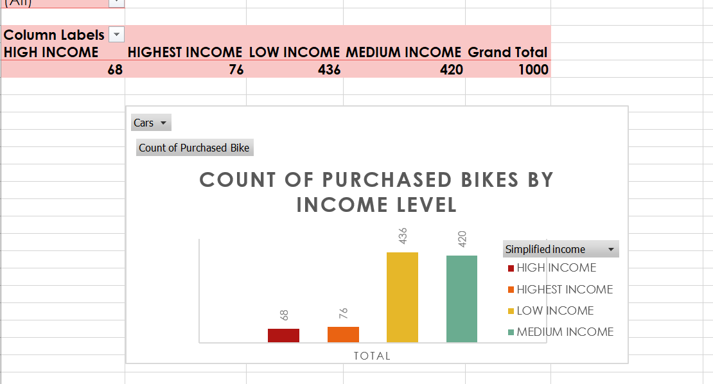
KPI--3 INCOME VS. PURCHASED BIKES CHART

Slide 12
INCOME VS. PURCHASED BIKES EXPLANATION
Purpose: Investigates the connection between income levels and bike ownership or purchases.
Key Insights:
Reveals trends in bike affordability or preference across income groups.
Identifies income levels with the highest interest in purchasing bikes.
Applications: Valuable for businesses in the cycling industry to target their offerings.

Slide 13
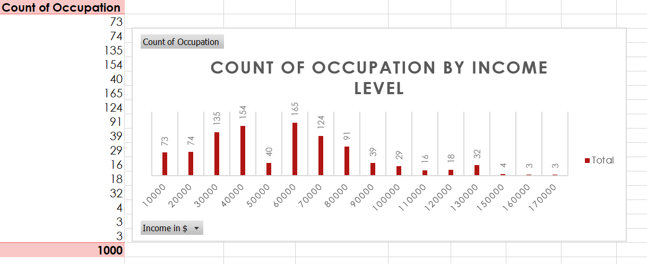
KPI--4 OCCUPATION VS. INCOME LEVEL CHART

Slide 14
OCCUPATION VS. INCOME LEVEL EXPLANATION
Purpose: Compares different job roles with their corresponding income levels.
Key Insights:
Shows which occupations are high- or low-earning.
Helps in understanding income disparities across professions.
Applications: Useful for career guidance, workforce planning, or analyzing labor market trends.

Slide 15
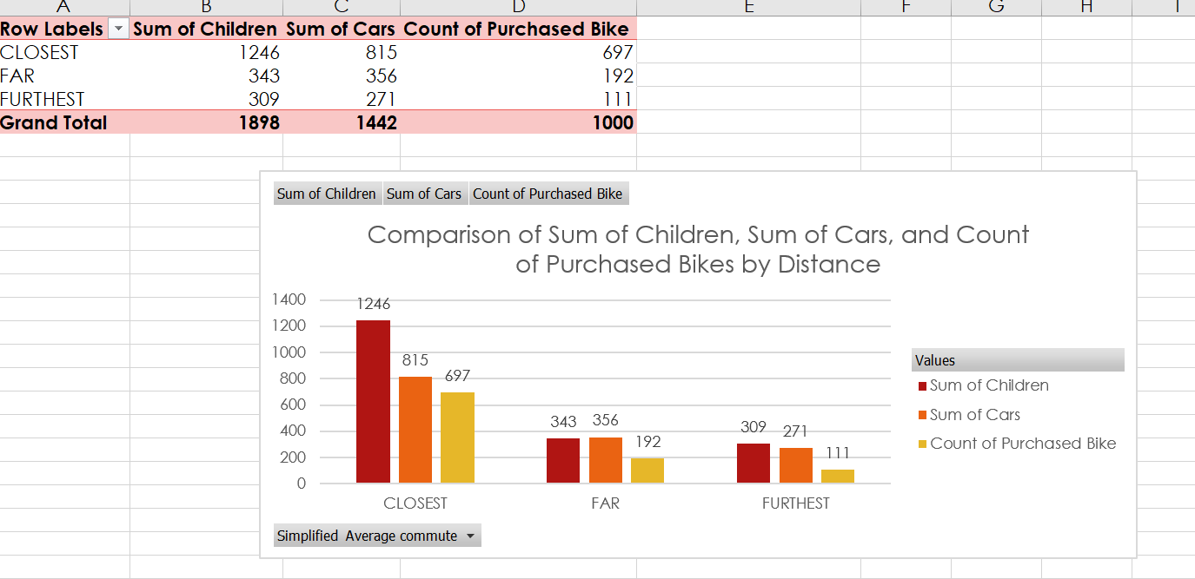
KPI 5-- SUM OF CHILDREN, CARS, AND BIKES BY DEMOGRAPHICS CHART

Slide 16
SUM OF CHILDREN, CARS, AND BIKES BY DEMOGRAPHICS EXPLANATION
Purpose: Combines demographic factors to explore patterns in household assets like children, cars, and bikes.
Key Insights:
Links demographic groups with specific asset ownership.
Highlights lifestyle differences among various demographics.
Applications: Helps businesses and policymakers tailor offerings or services based on asset ownership trends.

Slide 17
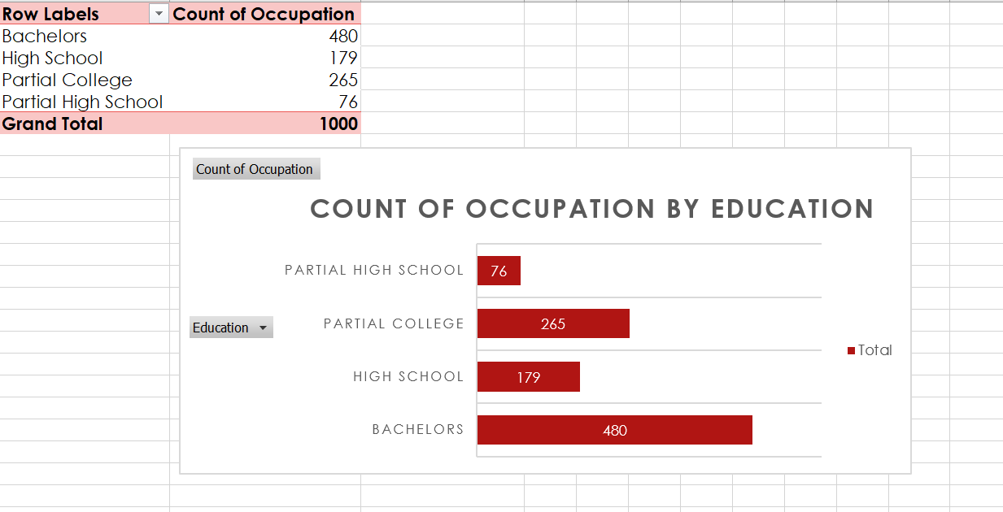
KPI 6 --OCCUPATION VS. EDUCATION EXPLANATION

Slide 18
OCCUPATION VS. EDUCATION EXPLANATION
Purpose: Analyzes how educational attainment aligns with job roles.
Key Insights:
Highlights the education levels required for certain occupations.
Identifies mismatches where individuals may be under- or overqualified.
Applications: Informs educational policies or career development programs.

Slide 19
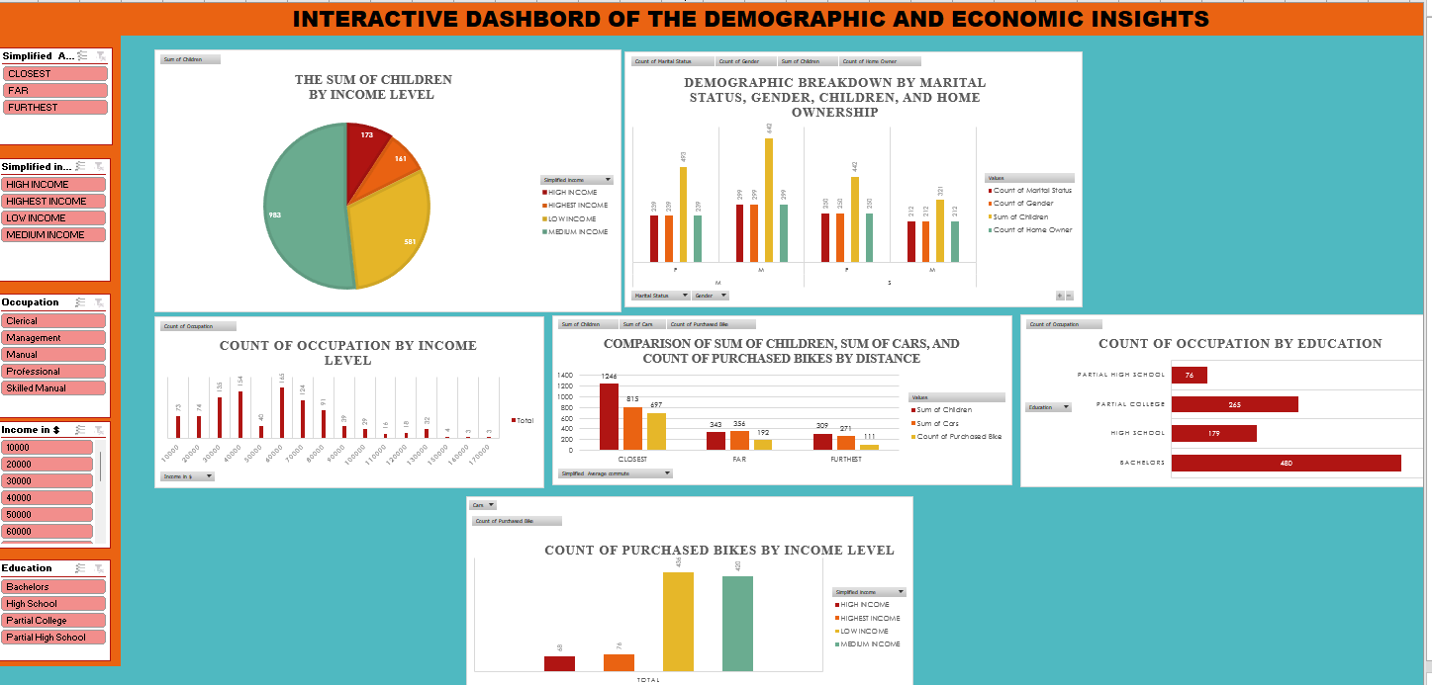
DASHBOARD

Slide 20
DASHBOARD-EXPLANATION
Purpose: Provides a visual summary of the most important metrics and trends derived from the data.
Key Insights:
Presents a clear, high-level overview of KPIs (e.g., income distribution, demographic trends, purchasing behavior).
Combines data from multiple sheets into actionable insights.
Applications: Acts as a quick-reference tool for stakeholders to understand key findings and make decisions.

